Slide 1

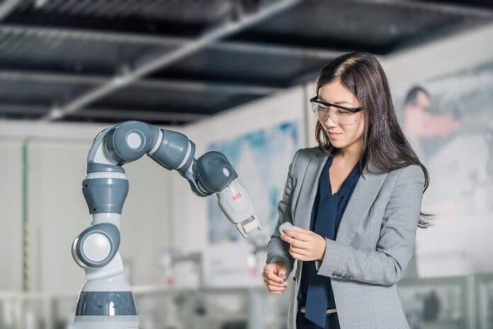
MULTI MODAL DATA FUSION AND PATH GENERATION USING REINFORCEMENT LEARNING FOR COBOTS
Mentor name : Dr. Anish Chand Turlapaty
Department of Electronics & Communication Engineering
Project ID : B24ACT01
Team:
Yalakanti Eswar S20210020332
Yele Midhilesh Kumar S20210020333
1

Slide 2
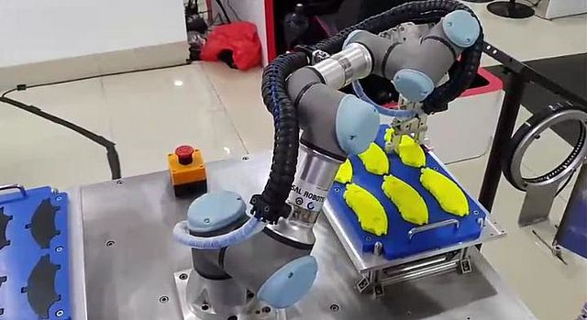

Content
01
Introduction
02
Objective
03
Data Collection
04
Data Analysis
05
Methodology
06
Work Done
07
Future goals
08
References
2

Slide 3

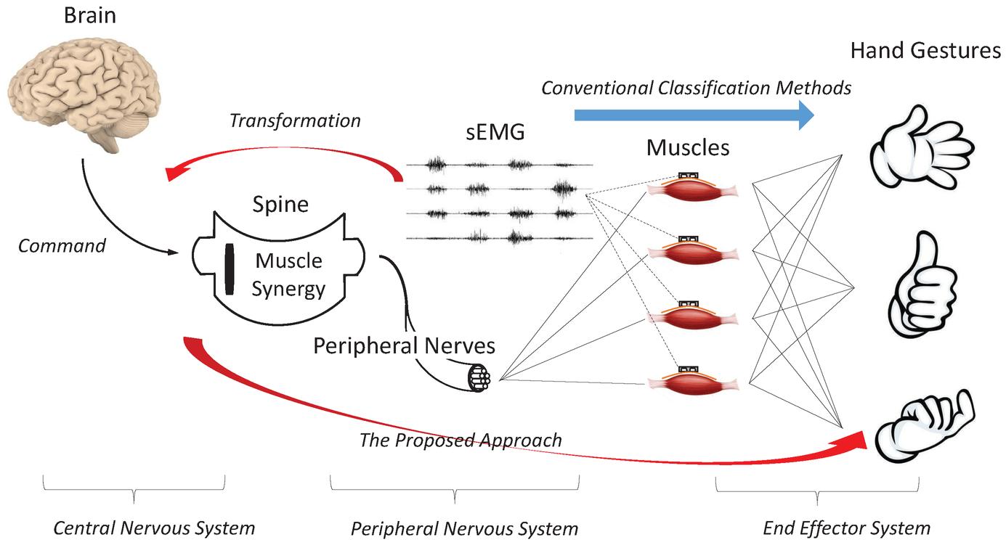
Introduction
Implementing collaborative robots is the main goal of our thesis research. To do this, we employ reinforcement learning for path planning .we will use Machine learning / deep learning for object detection and gesture classification.
Surface Electromyography (SEMG) is used to classify hand gestures by capturing muscle signals, facilitating intuitive control of a collaborative robot (Cobot) through gestures.
The RGB camera plays a dual role, aiding in object detection, path planning. It ensures the Cobot navigates safely during its operations in industrial environments.
3

Slide 4
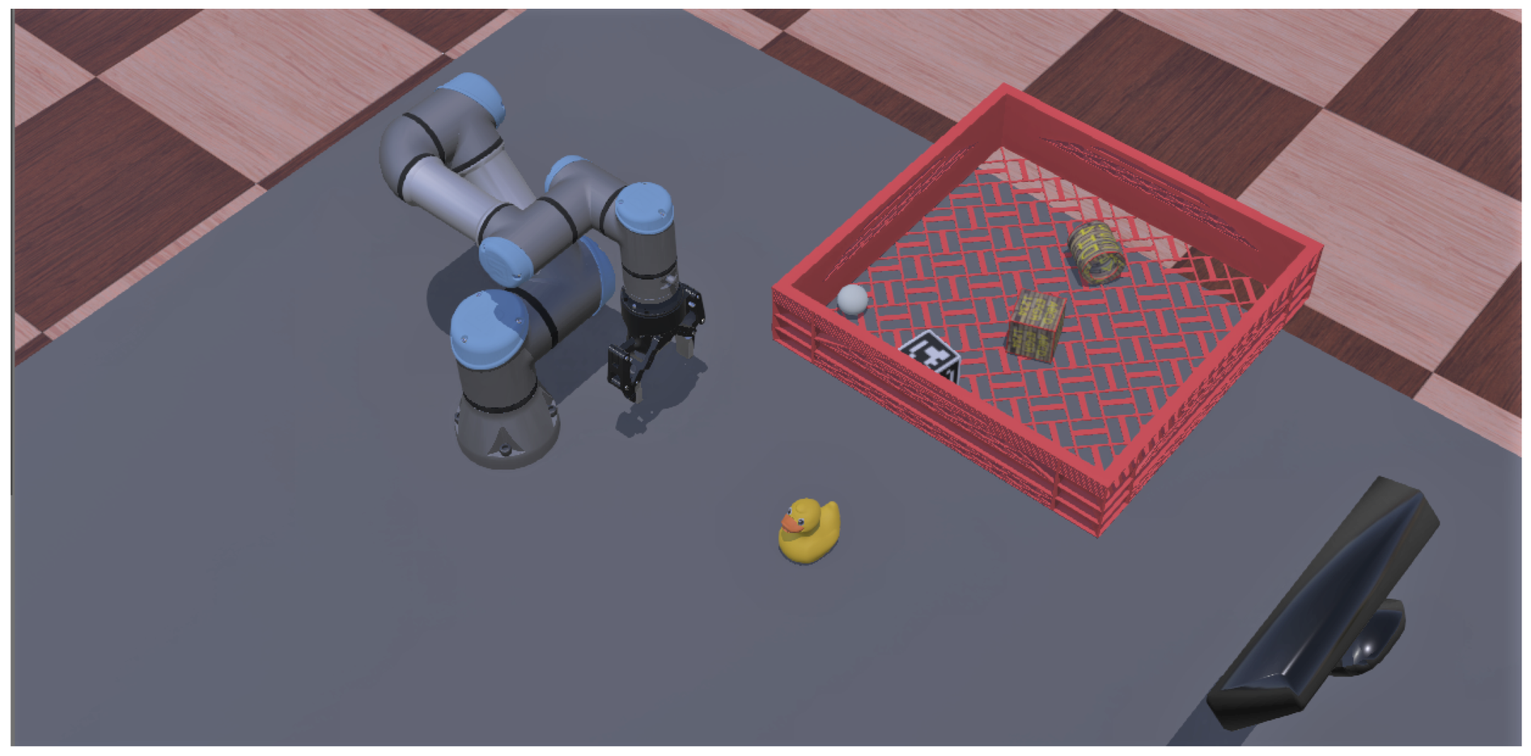
Task-parameterized learning from demonstrations is an approach where a robotic system learns how to perform a task by observing demonstrations, and the learning process is influenced by various task-related parameters.
TP-LfD, coupled with reinforcement learning, forms a robust system, enhancing adaptability and efficiency in cobot path planning for diverse industrial applications.
This approach bridges the gap between human intent and cobot actions, fostering effective human-robot collaboration .
4

Slide 5

Objective
Collect sEMG (Surface Electromyography), video, and Kinect sensor data simultaneously to ensure synchronized data acquisition to maintain temporal consistency across modalities.
Extract relevant features from each type of Data (SEMG, video, Kinect sensor data) and fuse them using data fusion techniques.
Utilize Kinect sensor data for depth analysis to divide the environment into three distinct zones based on depth information.
Develop a machine learning model using the fused data from sEMG, video, and Kinect sensor.
Train the model to understand the relationship between multimodal inputs and optimal path finding based on depth-divided zones.
Implement a Machine learning /deep learning model to achieve accurate and classification of hand gestures based on sEMG signals.
5

Slide 6
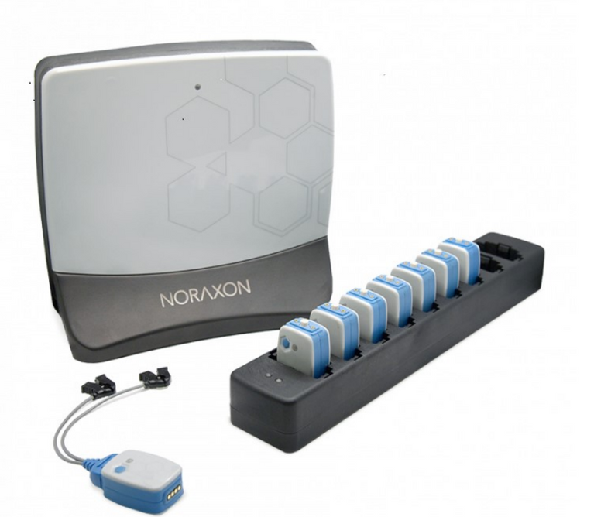
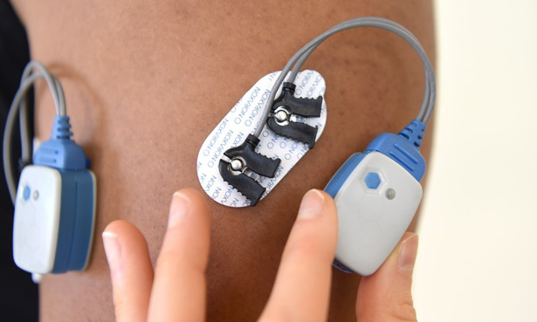
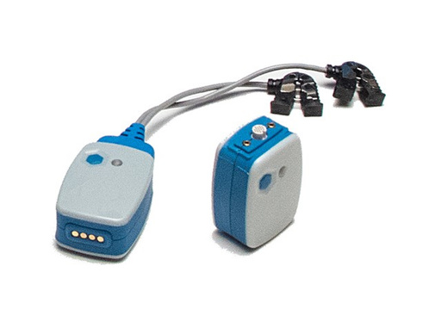
Data Collection
Sensor placement:
Electrode Placement on the muscle (Five electrodes):
Flexor digitorum superficials
Extensor carpi ulnaris
Brachioradialis
Extensor digitorum
Flexor carpi ulnaris
Fig.Sensor Placement
Fig. Noraxon for sEMG data collection
Fig. Electrode
6

Slide 7
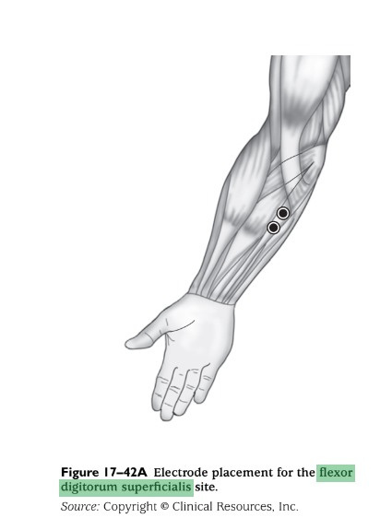
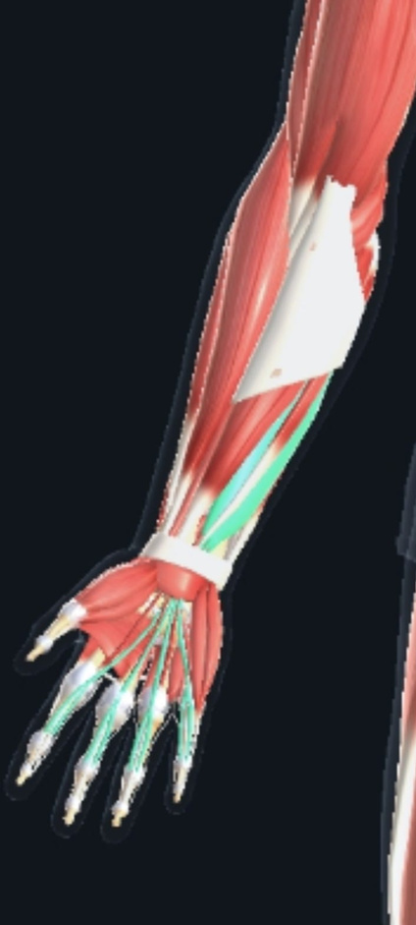
Data Collection
Flexor digitorum superficials:
Flexor digitorum superficialis is important in gesture classification as it aids in distinguishing between hand movements, particularly in actions involving finger.
7

Slide 8
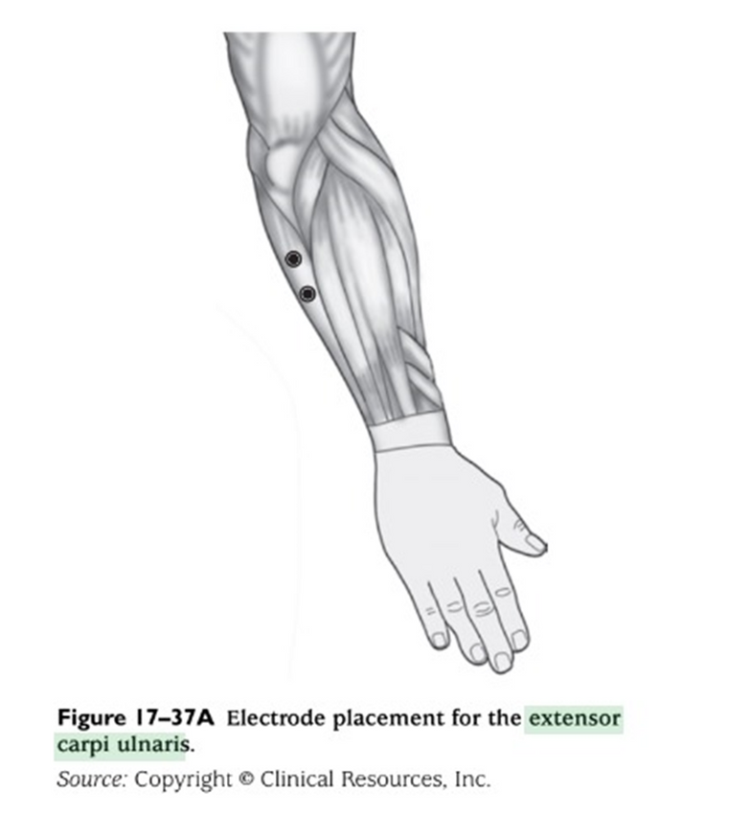
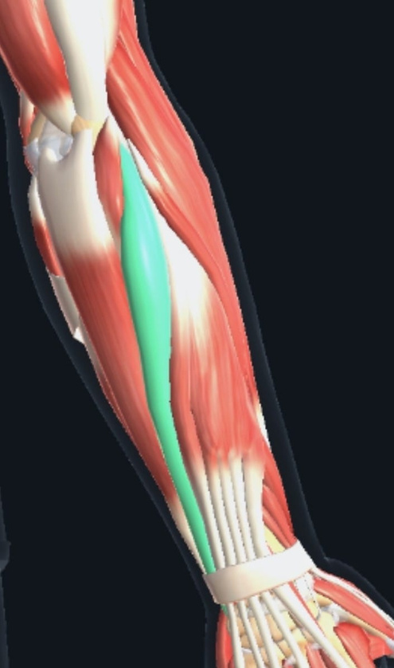
Data Collection
Extensor carpi ulnaris:
This muscle is crucial for wrist extension, is integral in tasks involving pulling the hand away from the palm and backward,
It offering valuable insights into movements like raising or pushing objects
8

Slide 9
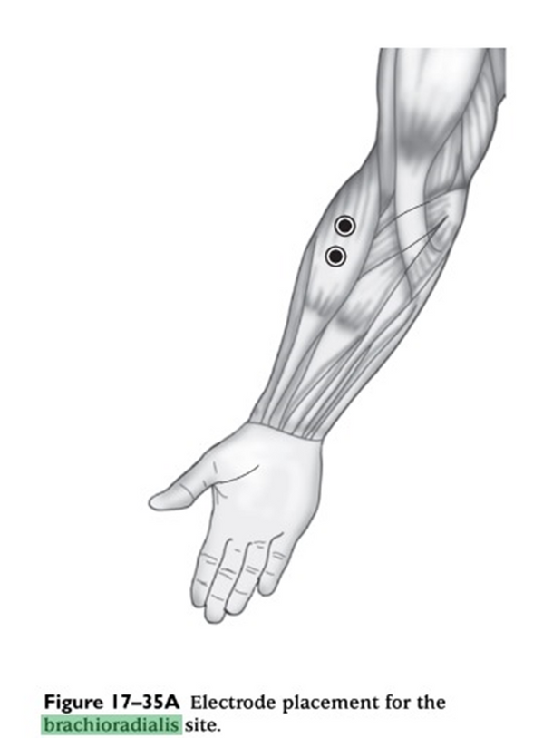
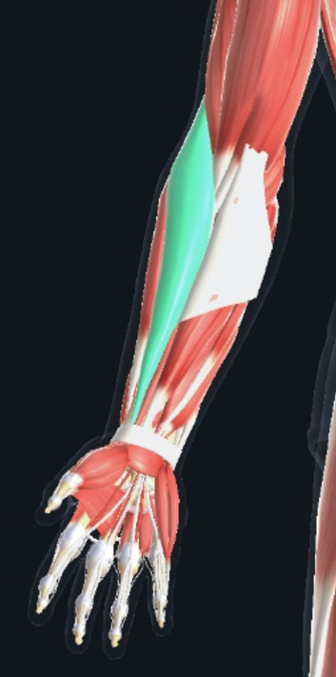
Data Collection
brachioradialis
The brachioradialis muscle aids in forearm rotation and flexion
It plays a crucial role in hand gestures by controlling wrist movement and stabilizing the forearm during gestures
9

Slide 10
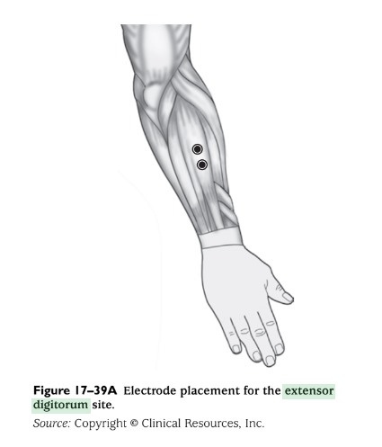
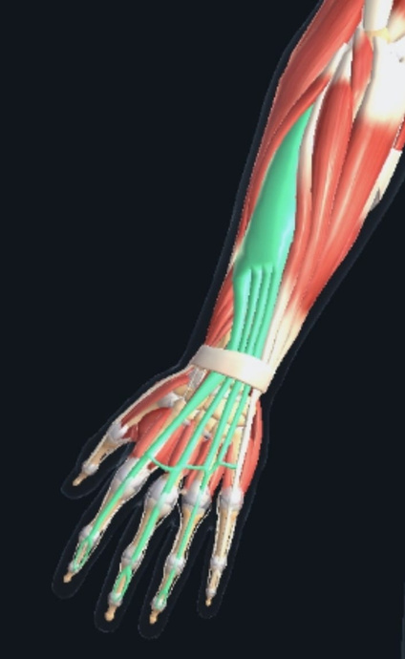
Data Collection
extensor digitorum
The extensor digitorum muscle plays a vital role in the classification of gestures because it allows the fingers to be extended.
This muscle is especially for those actions that involve spreading or stretching of fingers.
10

Slide 11
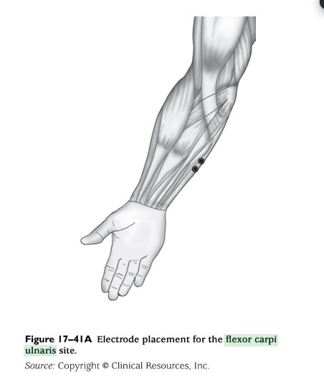
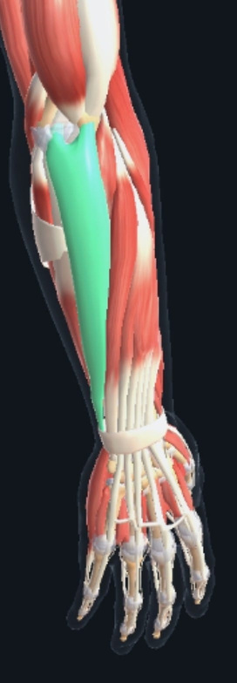
Data Collection
Flexor carpi ulnaris
Flexor carpi ulnaris is primarily involved in wrist flexion , contributing to hand gestures that involve movements such as grasping and gripping.
11

Slide 12
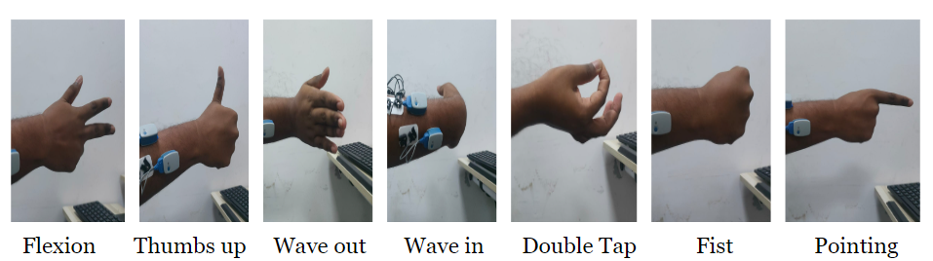
Data Collection
We gathered data from 4 subjects, each performing 7 distinct gestures and every gesture is repeated by 7 times.
Data is collected from Semg, kinect sensor and video camera
fig. Actions performed in data collection
12

Slide 13
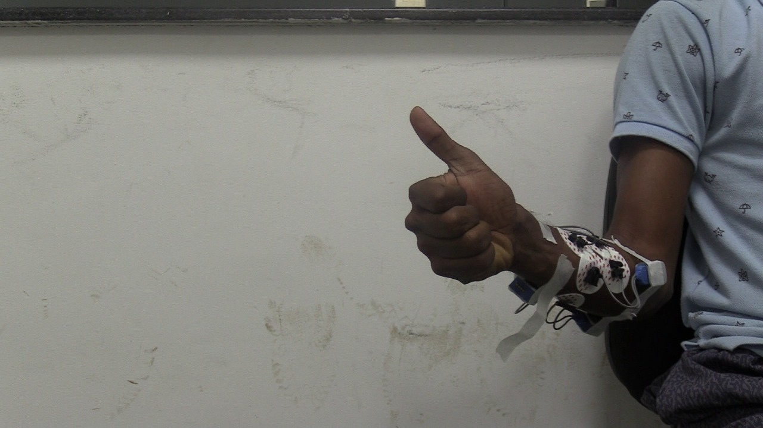
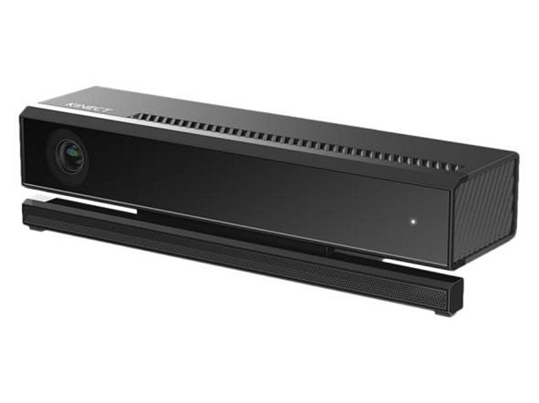
Data Collection
Semg is collected through five channels
Microsoft kinect for depth perception and Video camera is for spatial analysis
Fig. Microsoft kinect
Fig. Noraxon sensor for Semg
Fig. Subject performing OK symbol
13

Slide 14
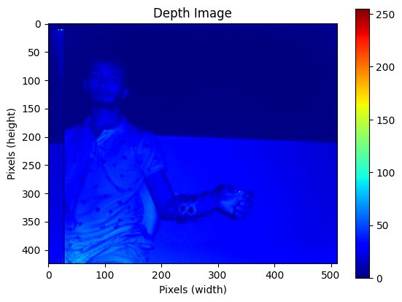
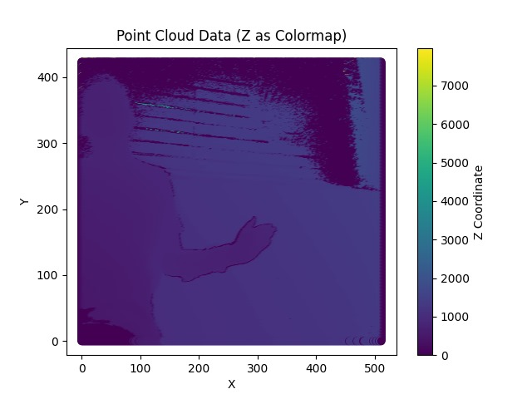

Data Analysis
Microsoft Kinect Sensor Data
Fig. IR Image
Fig. Subject performing Wave in
Fig. Subject performing
Fist
14

Slide 15
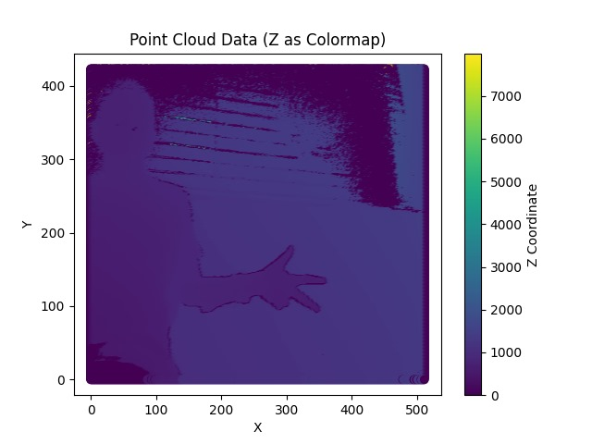

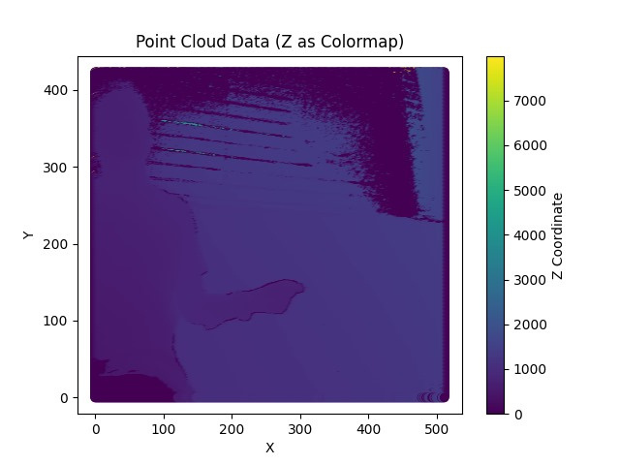
Data Analysis
Microsoft Kinect Sensor Data
Fig. subject performing Flexion
Fig. subject performing Ok symbol
Fig. subject performing double tap
15

Slide 16
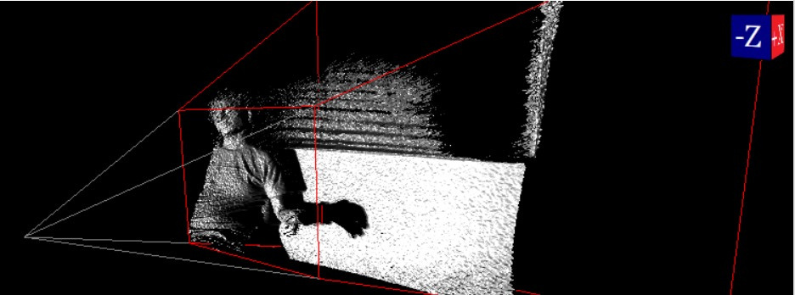
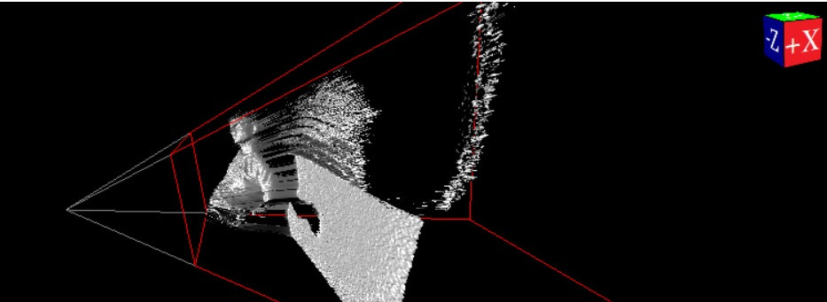
Data Analysis
Microsoft Kinect Sensor Data (3D Images)
Fig. 3D image for depth and path finding
Fig. 3D image for depth and path finding in different view
16

Slide 17
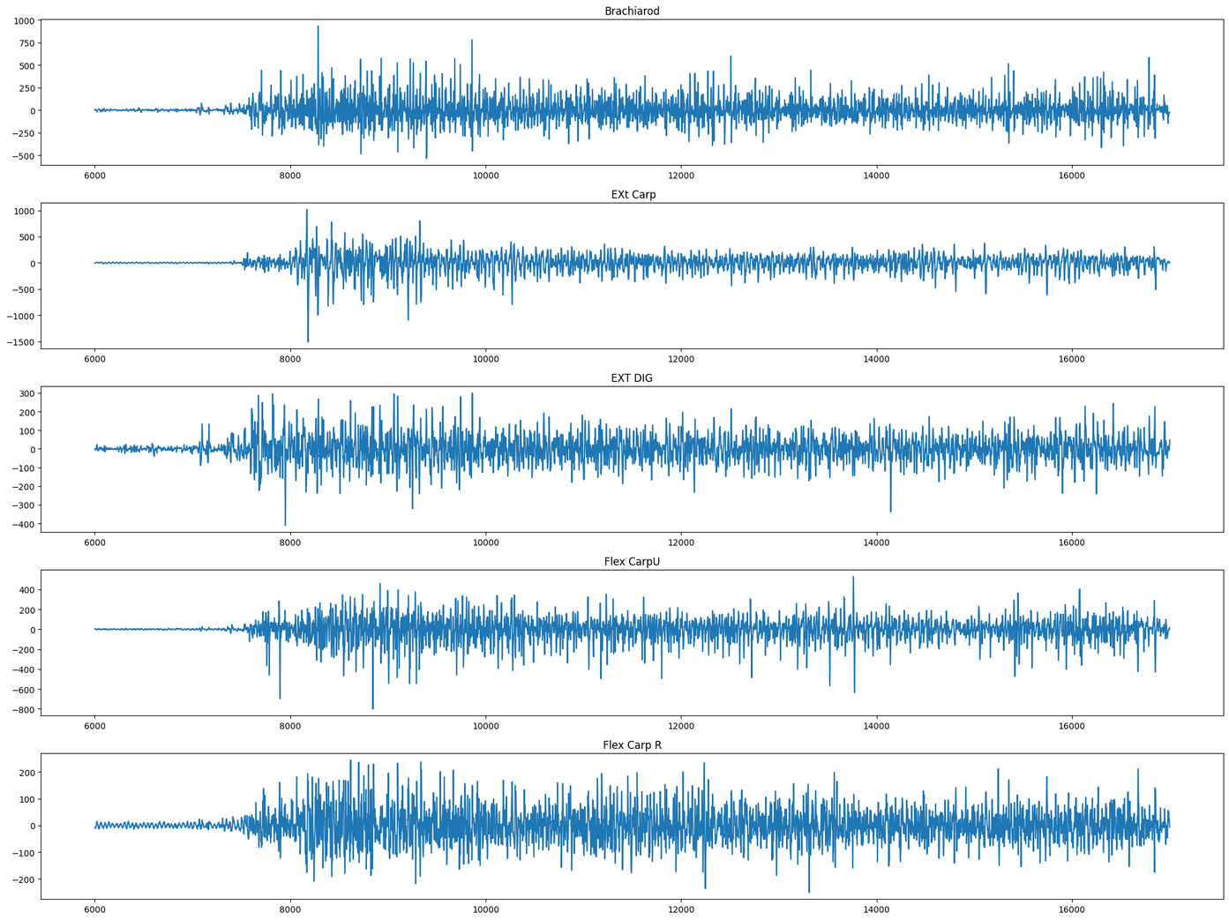
Data Analysis
Raw Semg signal
Fig. Raw Semg signal
17

Slide 18
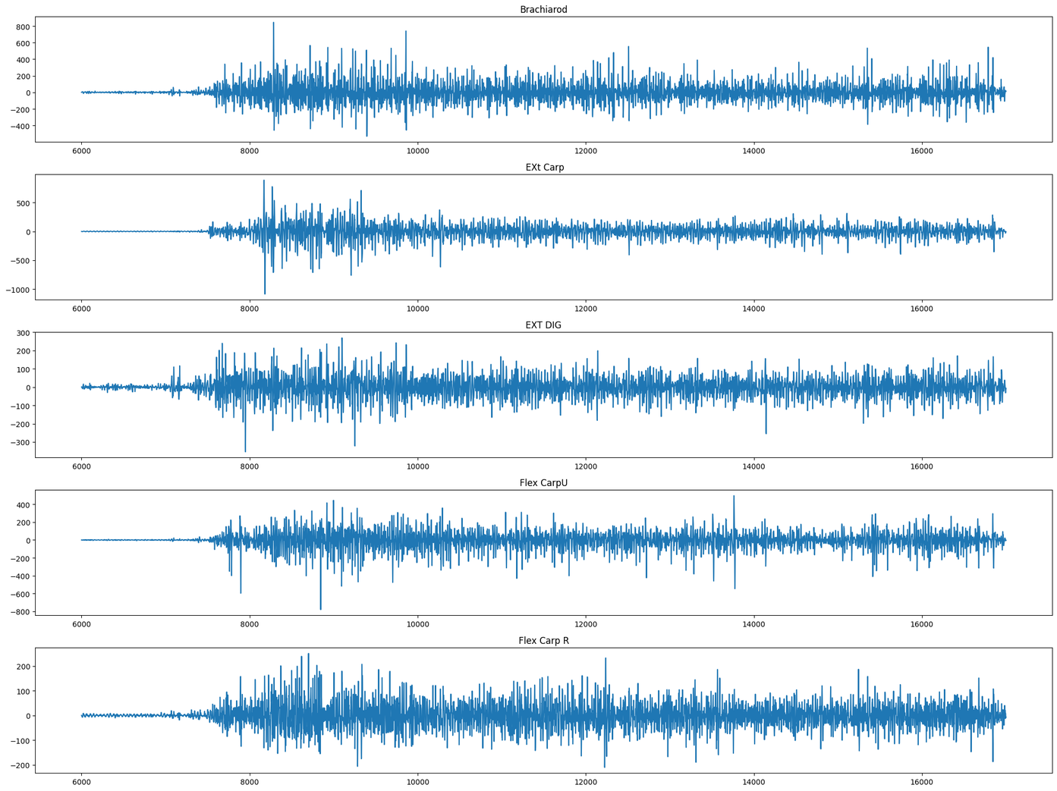
Data Analysis
SEMG siganl after filtering
18
Fig. Filtered Semg signal(Notch filter of 50 hz and denoise using sym8 wavelet

Slide 19
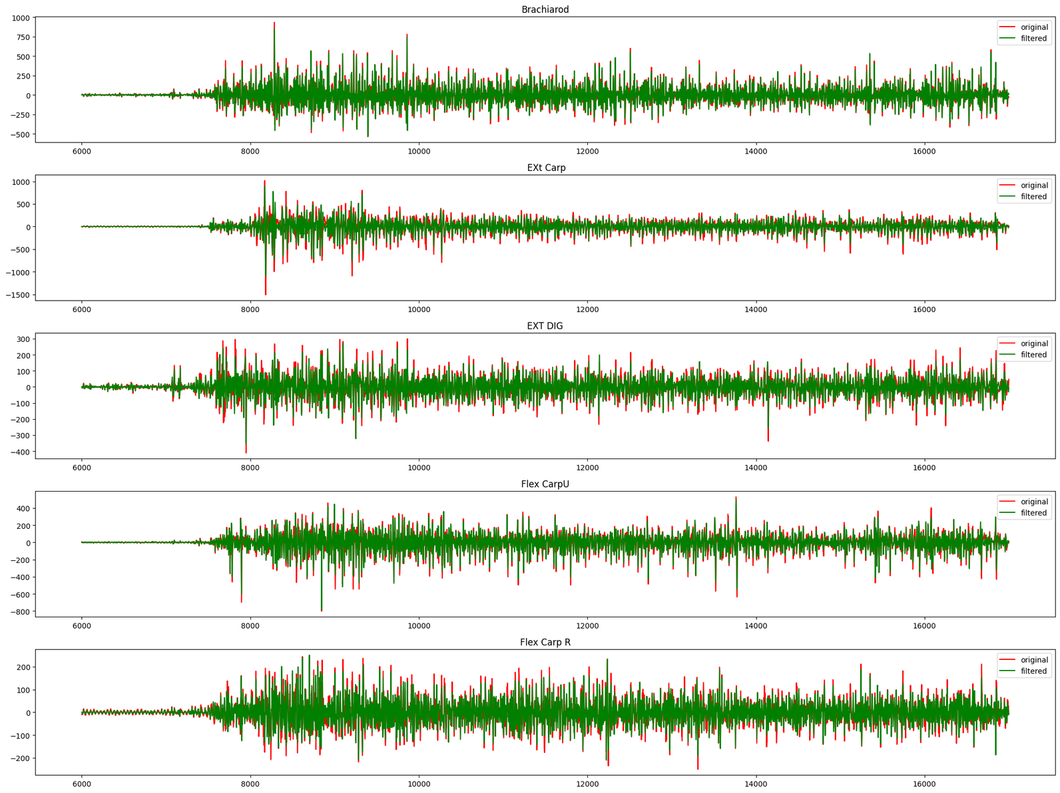
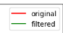
Fig. plot of both Raw Semg signal and filtered Semg signal
19

Slide 20
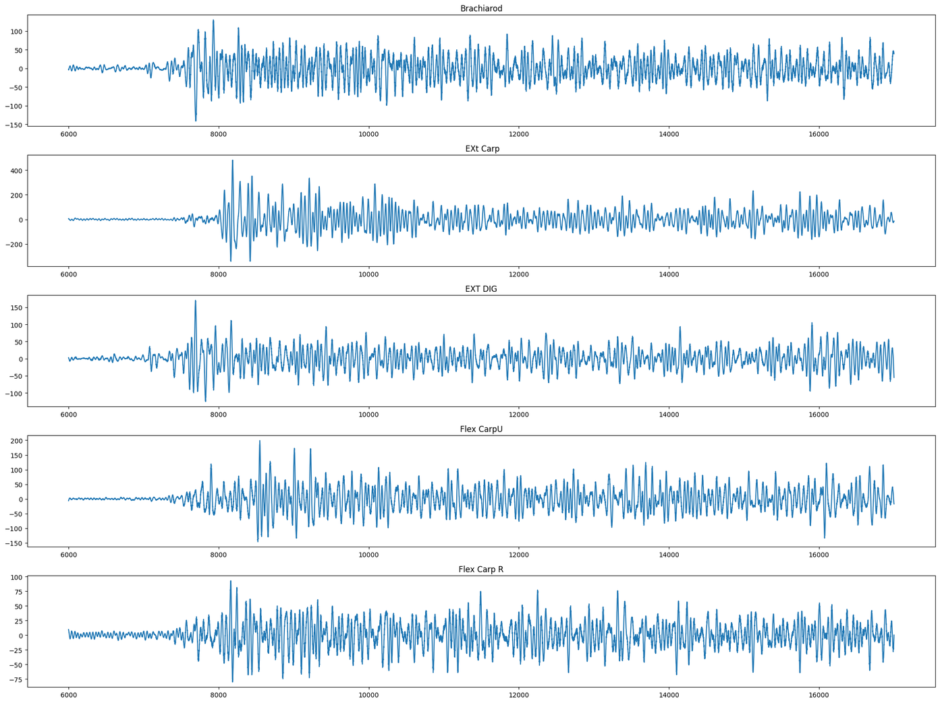
Data Analysis
20
Fig. the difference of Raw Signal and Filtered Signal

Slide 21
Data Analysis
21
Fig. the difference of Raw Signal and Filtered Signal

Slide 22
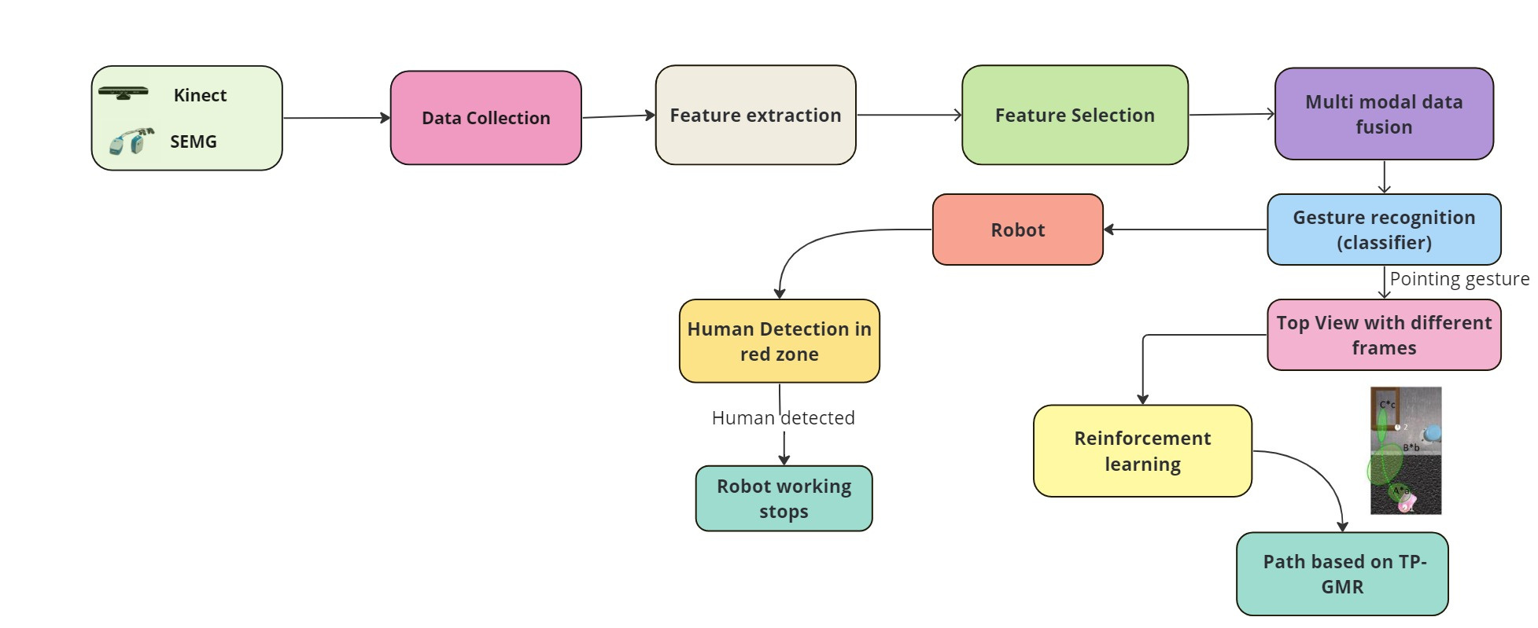
Methodology
video data
22

Slide 23





Work Done
Features extracted: Mean Value , Standard Deviation , Maximum Value , Minimum Value , Skewness , Kurtosis , Median , Line Length ,Mean of Vertex-to-Vertex Amplitudes, Variance of Vertex-to-Vertex Amplitudes , Mean of Vertex-to-Vertex Times , Variance of Vertex-to-Vertex Times , Zero Crossings , Amplitude Range , Mean of First Derivative , Maximum Value of First Derivative , Mean of Second Derivative , Maximum Value of Second Derivative, Hjorth Parameter Activity , Hjorth Parameter Mobility , Hjorth Parameter Complexity , Delta Power.
Libraries used:
23

Slide 24
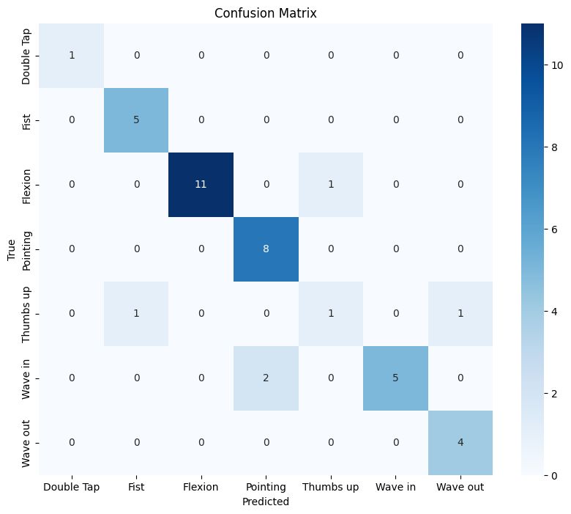
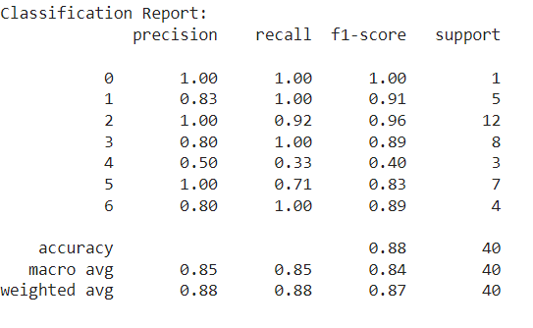
Work Done
Classification Model :
1. SVC(Support Vector classifier) : Window size=250 ms
SVC Model - Accuracy: 0.875
24

Slide 25
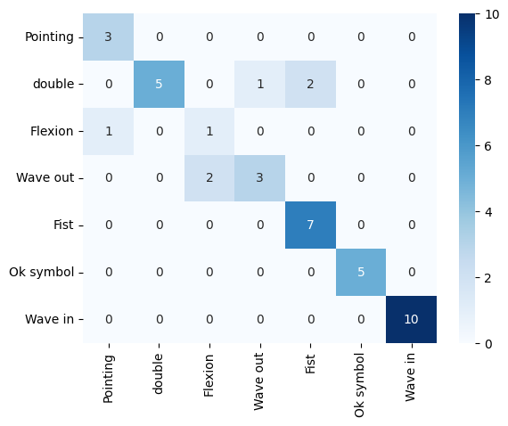
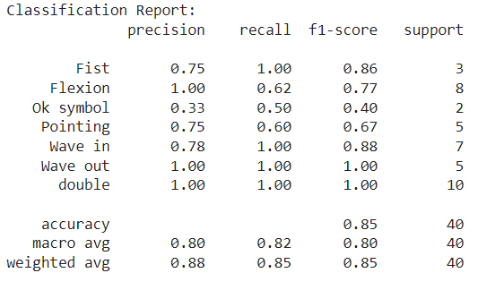
Work Done
Classification Model :
2. Cat Boost:
Cat Boost - Accuracy: 0.85
25

Slide 26
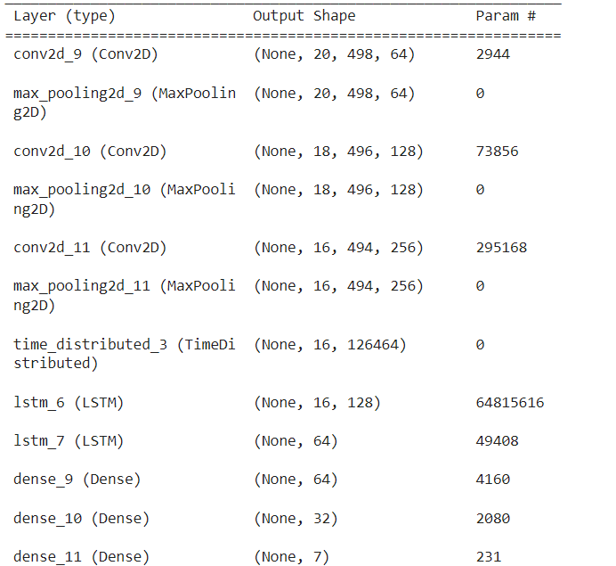
Work Done
Deep learning model :
model architecture
26

Slide 27
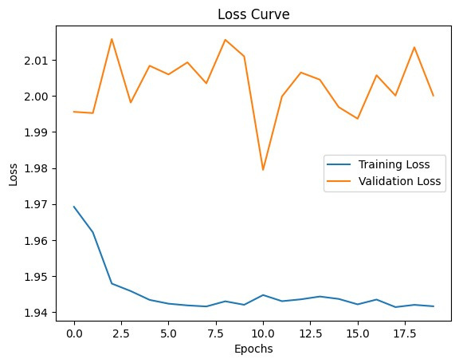
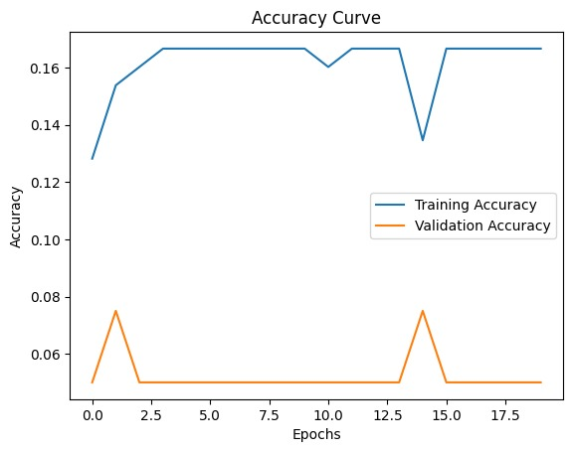
Work Done
Deep learning model :
Loss and accuracy curve
27

Slide 28
Work Done
S.No | Model | Accuracy | F1 Score
1. | SVC (Window size =250 ms) | 87.5% | 88%
2. | CatBoost | 85% | 85%
3. | XGBoost | 72.5 % | 73%
4. | Random Forest | 82.5% | 82.02%
5. | Deep learning | 16.67% | 16%
28

Slide 29
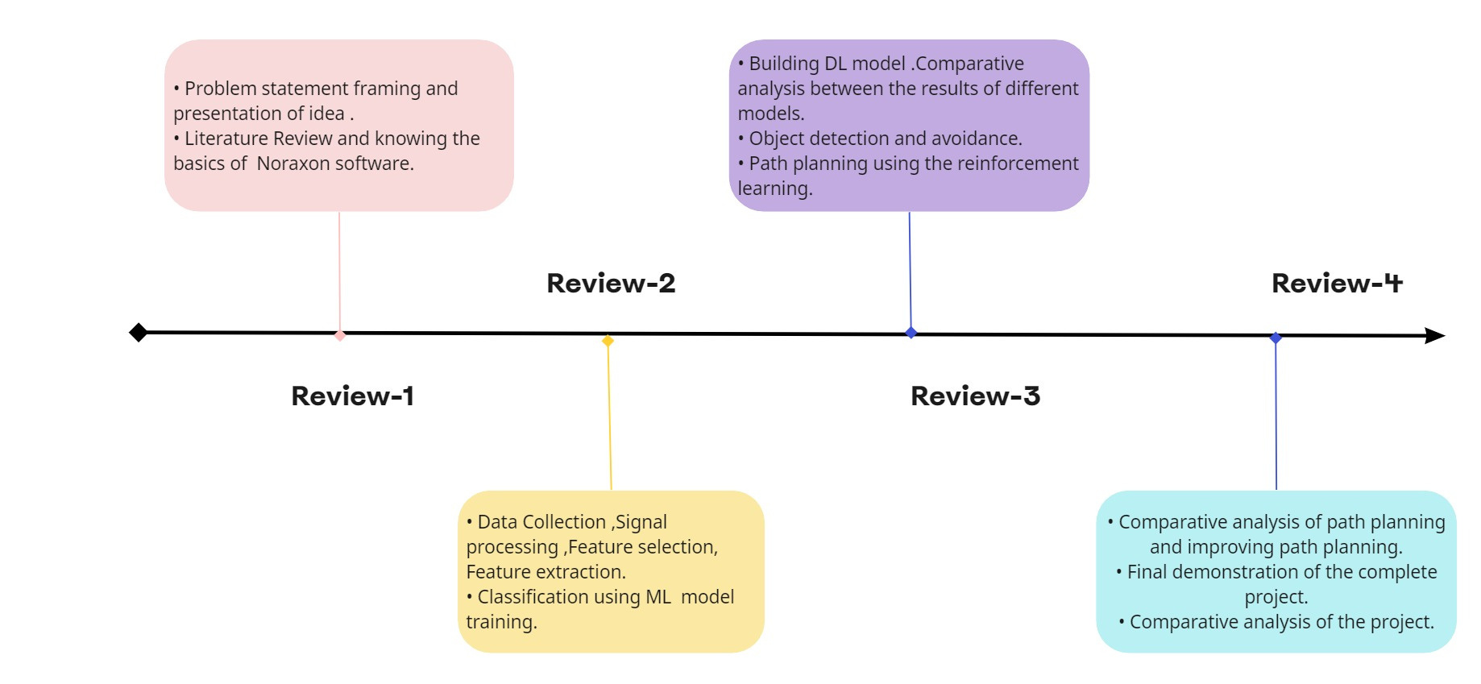
Future Goals
29

Slide 30
References
Google Scholar and Research Papers
Research papers:
El Zaatari, Shirine, et al. "Cobot programming for collaborative industrial tasks: An overview." Robotics and Autonomous Systems 116 (2019): 162-180.
Zhu, Jihong, Michael Gienger, and Jens Kober. "Learning task-parameterized skills from few demonstrations." IEEE Robotics and Automation Letters 7.2 (2022): 4063-4070
El Zaatari, Shirine, Yuqi Wang, and Weidong Li. "Reinforcement Learning based Optimization for Cobot's Path Generation in Collaborative Tasks." 2021 IEEE 24th International Conference on Computer Supported Cooperative Work in Design (CSCWD). IEEE, 2021.
Mendes, Nuno, Miguel Simão, and Pedro Neto. "Segmentation of electromyography signals for pattern recognition." IECON 2019-45th Annual Conference of the IEEE Industrial Electronics Society. Vol. 1. IEEE, 2019.
Gao, Qing, Jinguo Liu, and Zhaojie Ju. "Hand gesture recognition using multimodal data fusion and multiscale parallel convolutional neural network for human–robot interaction." Expert Systems 38.5 (2021): e12490.
Liu, Hongyi, and Lihui Wang. "Gesture recognition for human-robot collaboration: A review." International Journal of Industrial Ergonomics 68 (2018): 355-367.
30

Slide 31
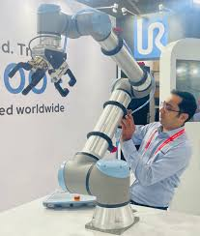
THANK YOU

